Slide 1
Lecture 43 outline: 12/04/2020
        Final homework due this afternoon.
        Skip SPN 10-13
        Problem SPN 10-10
        Final Exam
        Exam 2
        Boundary conditions at a current plane.

Slide 2
SPN 10-10a
A magnetic field in a radius “a” goes to zero as
What is the electric field at radius b?

Slide 3
SPN 10-10b
A charged insulating hoop of radius b lies outside a magnetic field in a radius “a”
The hoop has charge Q and mass m.
What happens to the hoop?

Slide 4
Final Exam

Slide 5
Exam 2

Slide 6
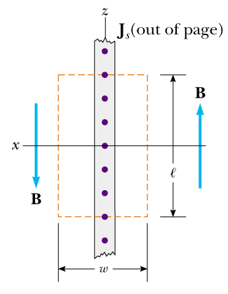
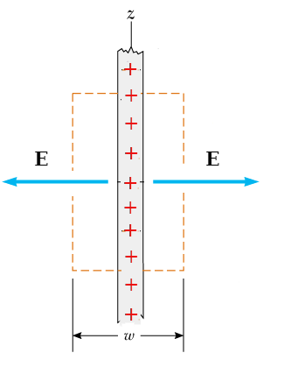
Infinite Current Sheet Infinite Charge Sheet

Slide 7
Ampere’s Law Faraday’s Law
(with displacement current)

