Slide 1
Lecture 33 outline: 11/04/2020
        Lorentz Force,
        B does no work
        Cyclotron motion
        e/m apparatus
        Ampere’s law, source of magnetic fields.
        Field of a wire
        What is current?
        Force on a current
        Force between wires
        Field of a solenoid

Slide 2
Lorentz Force
B does no work?

Slide 3
Cyclotron motion

Slide 4
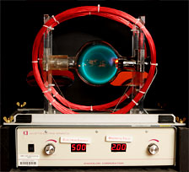
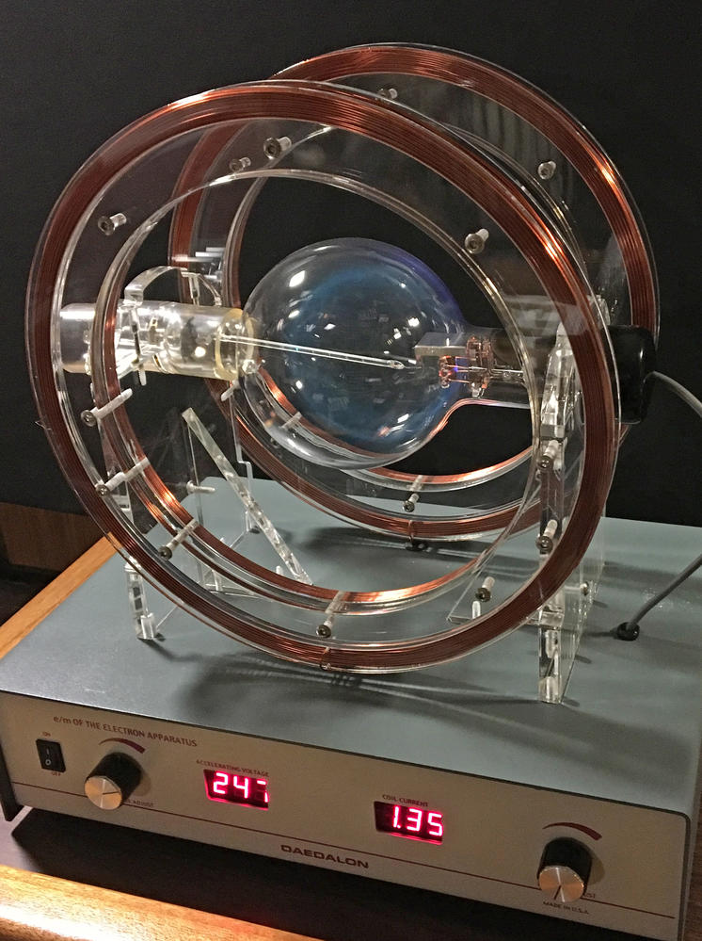
e/m apparatus

Slide 5
e/m apparatus
Measurements, V=100~V, I=0.5 Amps, r=7 cm, B=1200 uT

