Slide 1
Lecture 28 outline: 10/23/2020
    Discord for homework help??
          Include Sonnenfeld?
          Identify host?
    Chapter 4
    Force and torque on dipole
        Problem RS 7-05
        RS 7-07 Breakout rooms
    Electric fields in matter
      Polarization
      Bound Charges
        RS 7-09

Slide 2
Force and Torque on a dipole

Slide 3
Problem RS 7-05 Torque induced by dipoles on eachother

Slide 4
Problem RS 7-07 Force between charge and induced dipole.

Slide 5
Electric Fields in Matter
Alpha is called “polarizability”
Polarization is dipole moment/volume
Chi is called “electric susceptibility”
Epsilon is called “permittivity”
Epsilon_r is called “relative permittivity” or
“dielectric constant”

Slide 6
Units Check

Slide 7
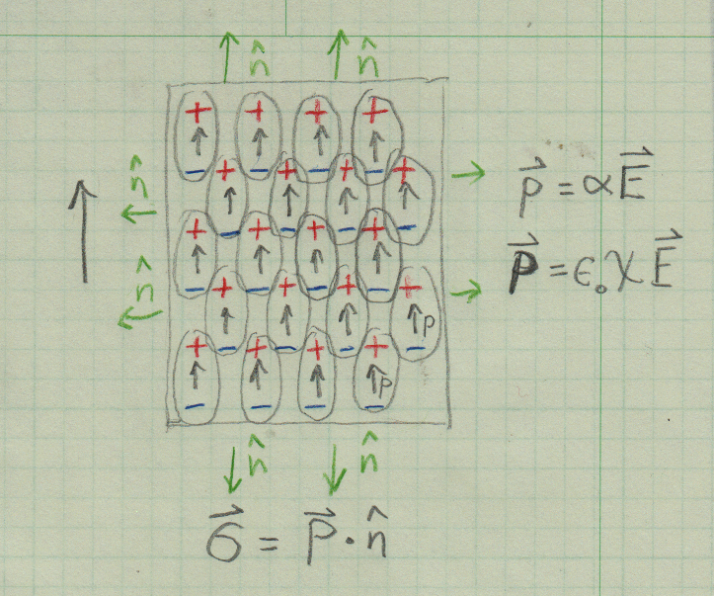
Polarization = Dipole moment per Volume

Slide 8
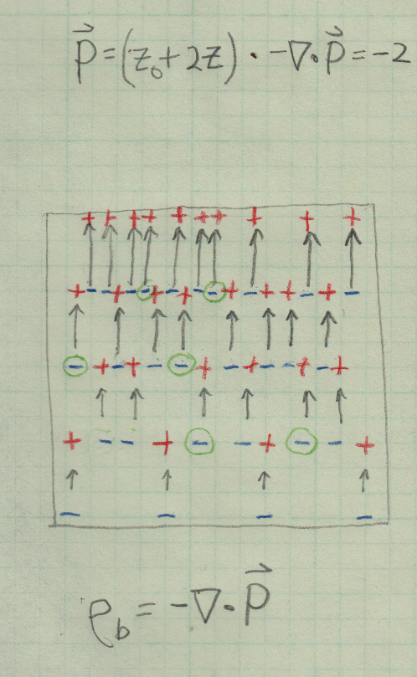
Polarization = Dipole moment per Volume

Slide 9
Real similar to RS 7-09
Imagine a cube centered at origin with polarization
The cube has side “a”
What is the bound surface and volume charge on the cube?

Slide 10
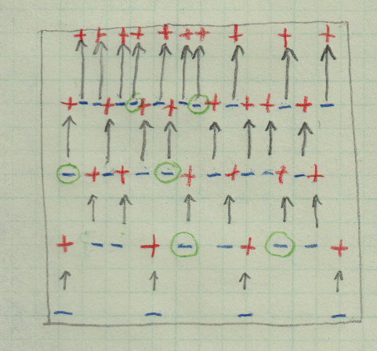
Gauss with Free and Bound Charge

