Slide 1
Lecture 25 outline: 10/14/2020
No classes FRIDAY!
Multipole expansion
    Vector form of dipole term
    Potential and field of dipole in spherical coords
Application
    Conducting sphere in uniform E-field
    Induced dipoles

Slide 2
Show that the dipole potential may be written

Slide 3
What is the electric field of a dipole in spherical coordinates?

Slide 4

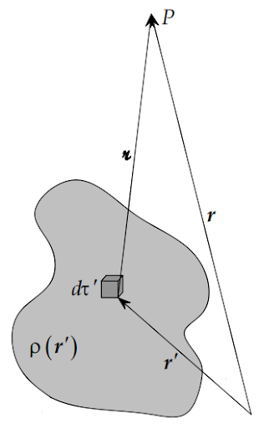
Multipole expansion

Slide 5
Legendre Polynomials

Slide 6
HW6-05 A sphere of radius R has charge for r<R defined as:
Calculate the potential
for z>>R.

Slide 7
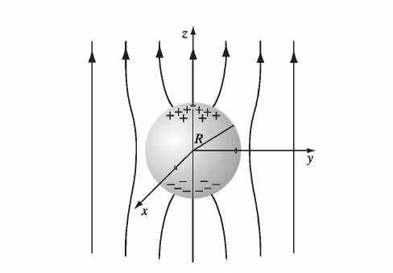
HW6-07 A conducting sphere of radius R is placed in a uniform electric field .
What is the potential inside and outside the sphere?

Slide 8
What is the general solution to Laplace in spherical coordinates?

