Slide 1
Urban Heat Island (UHI)
Steven Goluska

Slide 2
https://www.youtube.com/watch?v=4SihdPRRMPI

Slide 3
Bubble of heat formed over a city

Slide 4
What is the UHI Effect?

Slide 5
What is the UHI Effect?

Slide 6
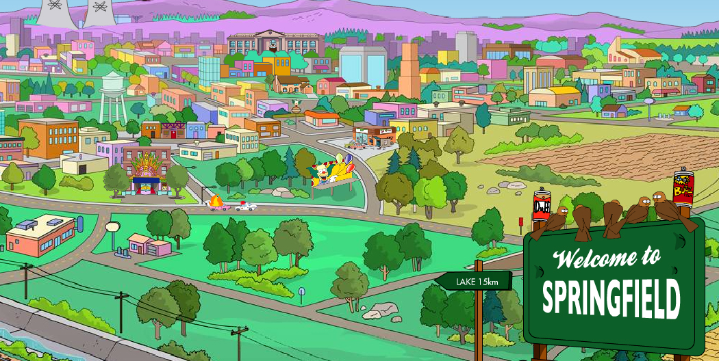
What causes the UHI Effect
Increase in dark materials to trap heat and reradiate later
Increase in thermally conductive materials
Decrease in vegetation
Decrease in surface water

Slide 7
Effects on clouds

Slide 8
UHI Effect on rain

Slide 9
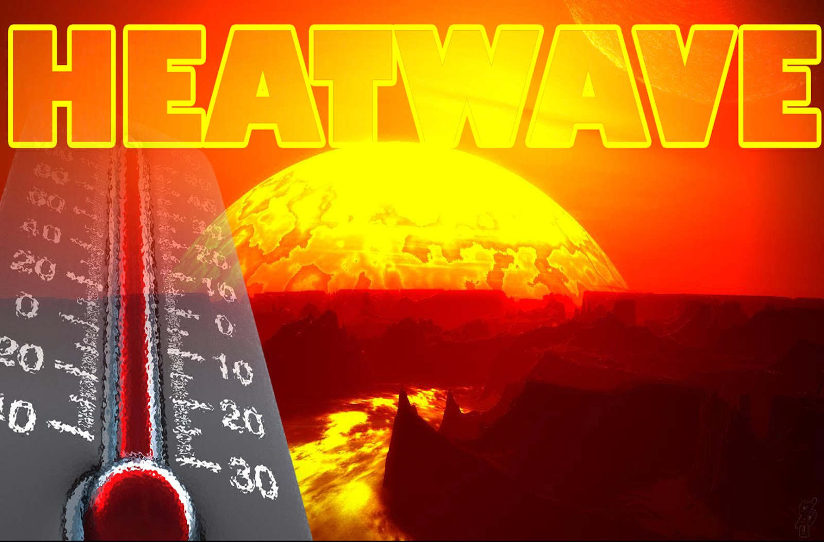

Slide 11
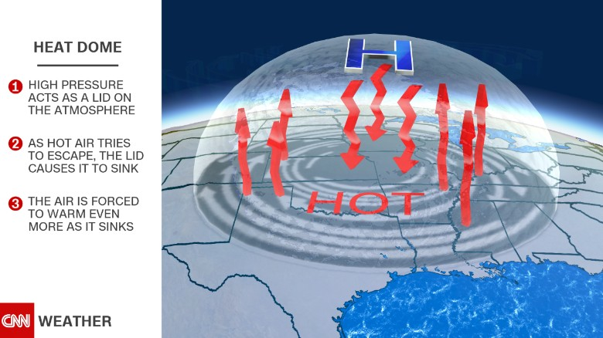

Slide 12
High pressure systems lock in heat

Slide 13
UHI Effect or Heat Wave
UHI
Heat Wave
Anthropogenic (human caused)
Caused by building materials and vegetation/ surface water loss.
Only occurs in urban environments.
Natural
Caused by high pressure systems staying in place.
Can happen in urban or natural environments

Slide 14
Is UHI Effect a true problem?

Slide 15
Is UHI Effect a true problem?

Slide 16
Is UHI Effect a true problem?

Slide 17
Is UHI Effect a true problem?

Slide 20
Is UHI Effect a true problem?
${\text{About}\text{ ½ }\text{the} \text{human} \text{population} \text{on} \text{Earth} \text{dwell} \text{in} \text{cities}\text{.}}_{1}$
Large cities across the globe.
Data interpretation issues?
Potential other effects on a broader scale?

Slide 21
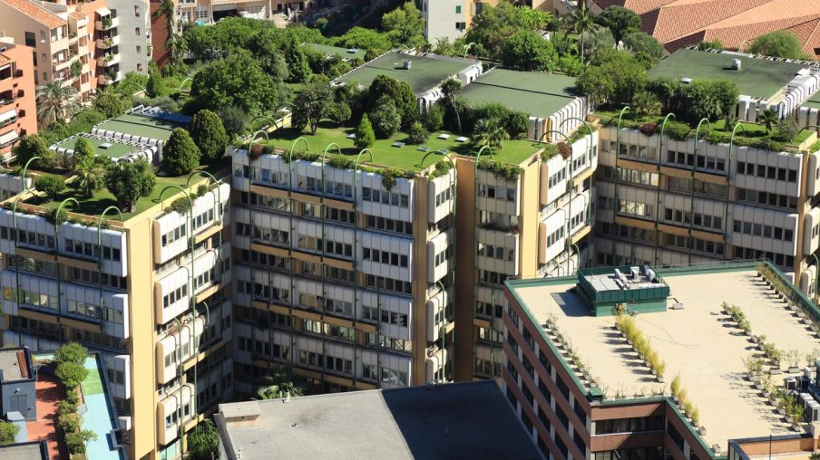
How can we mitigate the UHI Effect?
Reflective materials
Environmental heat
sinks
Increase parks and
planted environments
Road colors
Roof top gardens

Slide 22
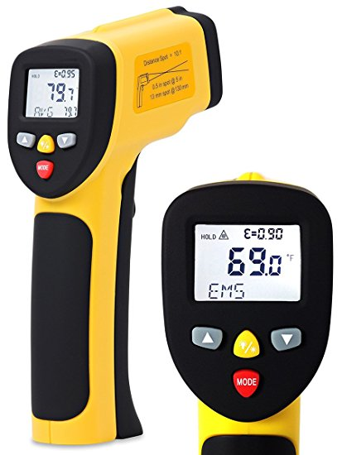
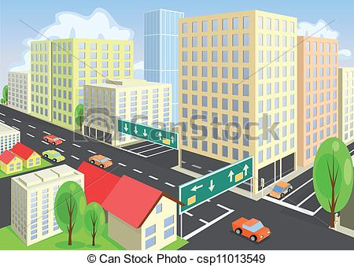
Teaching through investigation
Needed materials

Slide 23
Teaching through investigation
Data gathering
Take temps at
dots, also let students
take temps anywhere
else they would like.

Slide 24
Teaching through investigation
Plot data
Interpret

Slide 25
Referances
1- TWO DECADES OF URBAN CLIMATE RESEARCH: A REVIEW OF TURBULENCE, EXCHANGES OF ENERGY AND WATER, AND THE URBAN HEAT ISLAND.
A. JOHN ARNFIELD (2002)
Mitigating the Urban Heat Island effect through building envelope modiﬁcations.
Anurag, Kandya a, Manju, Mohan b

Slide 26
Questions

