Slide 1
The New Mexico dynamo: the past, the present, and the future
Jiahe Si, Stirling Colgate, Art Colgate,
Richard Sonnenfeld, Joe Martinic
(New Mexico Institute of Mining & Tech)
Mark Nornberg
(University of Wisconsin, Madison)
Hui Li
(Los Alamos National Lab)

Slide 2
Outline
New Mexico liquid sodium αω-dynamo experiment is based on a star-disk collision model.
Apparatus for ω-phase has been set up with Re up to 1.4x10⁷ and Rm up to 94.
X8 ω–gain has been obtained in near-stable Taylor-Couette (TC) flows.
Recently, ω–gain and β-effect have been investigated in turbulent TC flows.
The α-phase is being planned, as well as DAQ system upgrade.

Slide 3
Star-disk collision model
ω-effect: differential rotation
Seed poloidal field
Toroidal field
α-effect: plumes created by star-disk collisions

Slide 4
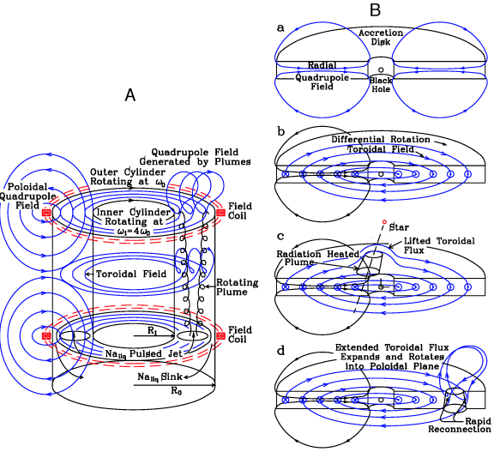
Our experiment
Liquid Sodium
plasma
Taylor-Couette flow
ω-effect
Plumes created by Jets
α-effect

Slide 5
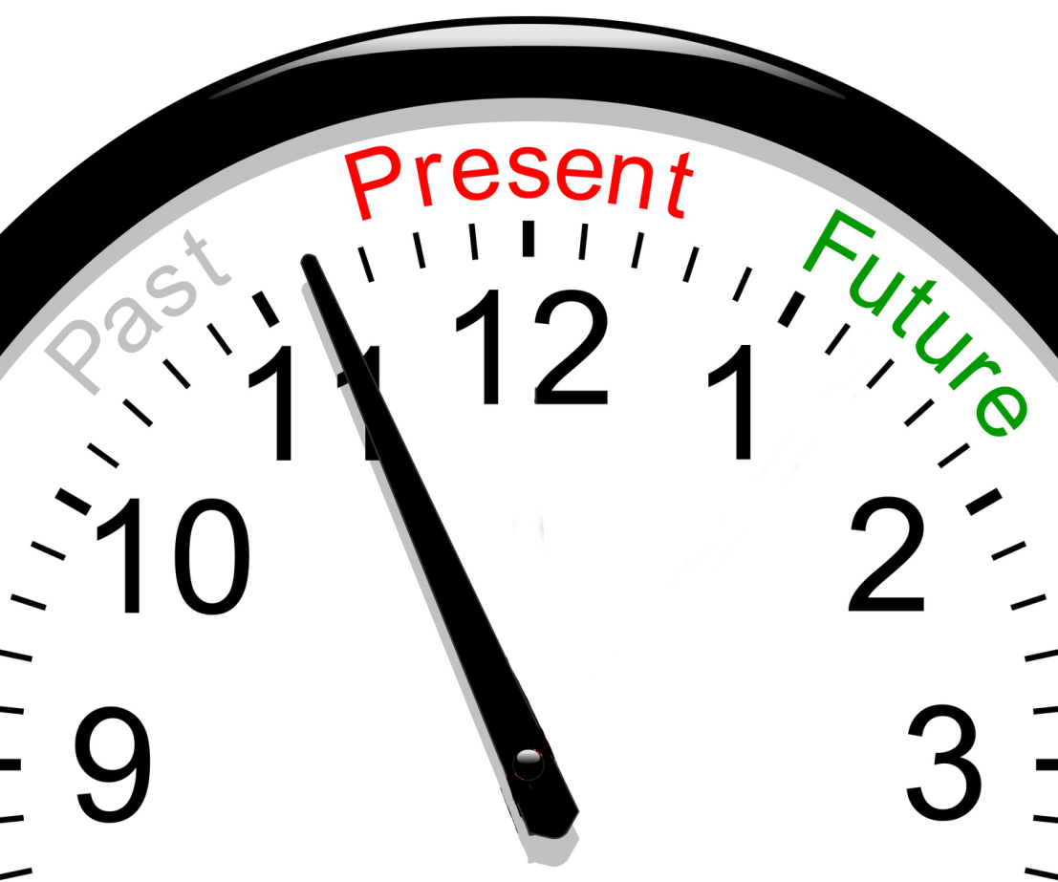

Slide 6
α-helicity has been demonstrated in water experiments

Slide 7
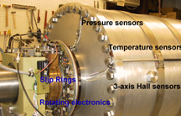
Key parameters of the NM dynamo experiment
Outer cylinder: 0.6 meter diameter
Inner cylinder: 0.3 meter diameter
Working fluid: liquid sodium.
Speed: 17.5 (inner) & 70 Hz (outer)
Stable Couette flow, Re = 1.0x10⁷,
Rm = 94 at T = 110ºC.

Slide 8
schematic of the apparatus
Couette Sheared Magnetic Field,
toroidal
Couette Flow (Sodium)
Magnetic Probe
3-axis Hall Sensors
At 6 radii
Hot Air
Pressure Transducers
Belt Drives
Inner Cylinder
Outer Cylinder
Ωout
Plume Ports (Blocked off)
Ωin
Thrust Bearing
Rotating
Board
Ekman flow
Co-Axial Drive Shafts, Steel
Tr3 Tr4
Rout/Rin = 30.4cm/15.2cm=2:1;
Ωout/Ωin=17.5Hz/70Hz=1:4;
Re~1.0x10⁷ Rm~94
Tr1 Tr2
Hot Air
Safety Shield, ¼” Steel
Coil 2
Coil 1

Slide 9
The ω-gain (B_{Φ}/B_{r0}) is up to x8 in near-stable TC flows when both cylinders spin at 68 (inner) and 17.5 Hz (outer) (Rm = 94)
S. A. Colgate, H. Beckley, J. Si, etc, Phys. Rev. Lett. 106, 175003 (2011)
Measurement at 68 and 17.5Hz has been repeated later, similar result has been obtained.

Slide 10
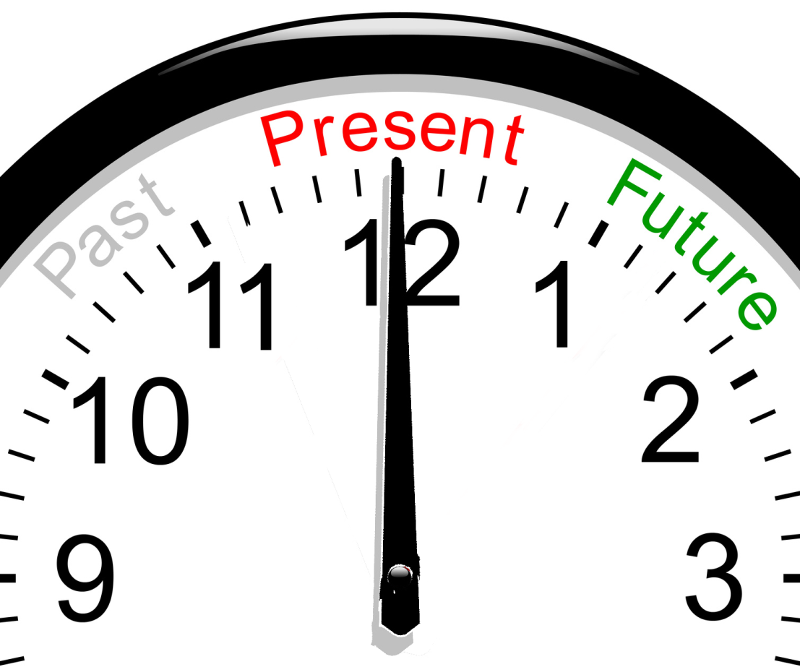

Slide 11
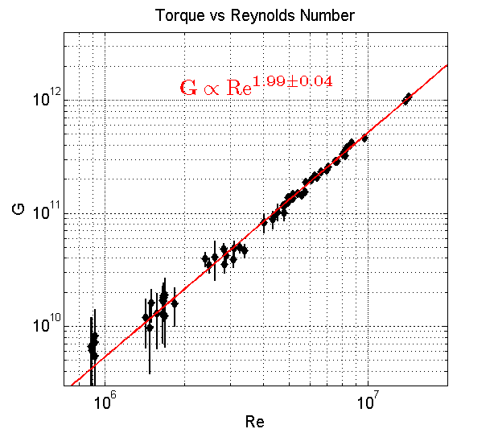
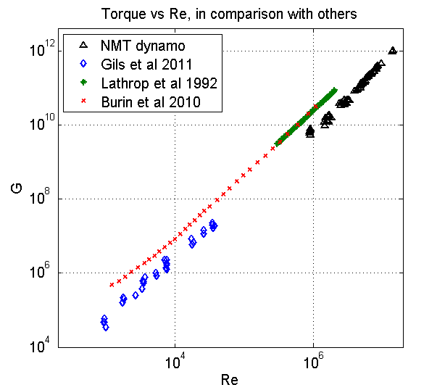
Experimental measurements for the non-dimensional torque have been extended to Re = 1.4x10⁷ in turbulent TC flow with outer cylinder stationary(water)
When the outer cylinder is stationary, non-dimensional torque
Notes:
Viscosity is calculated by measured T

Slide 12
Enhanced resistivity due to turbulence can be inferred by measuring ω-gain.
Power dissipation rate per unit mass
The size of the largest eddies is limited by the size of the apparatus, L. If we take
When
At 48Hz (inner), 0Hz(outer) , Re=8x10⁶, for water at 28ºC, T=70N.m. This gives u~3.75m/s~8%Uin (L=15cm)
Now
At 48Hz (inner), 0Hz(outer) , for sodium at 110ºC, Rm = 86,
μ₀β=2x10⁻⁷~2η

Slide 13
Enhanced resistivity due to turbulence can also be inferred by measuring the rise time τ of magnetic field inside the flow when an external axial field is applied.
B
Na
Al
η
j
Higher η, shorter τ Smaller R, longer τ
Without Na
With Na
For infinitely long cylinder
Notes:
We also studied effect of turbulence by making the outer cylinder stationary. For η≈∞, rise times at diff Rs are the same (put in the card)

Slide 14
However, rise(fall) time measurement shows no evident sign of enhanced resistivity (β-effect)

Slide 15
Also no gain slope reduction was seen

Slide 16
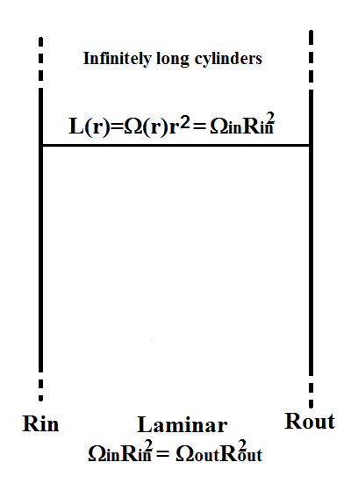
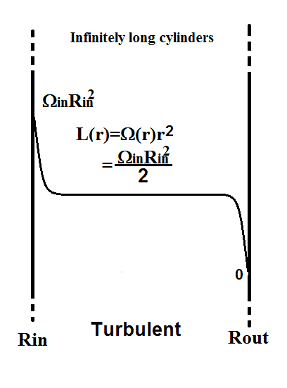
For current experimental setting, the dynamo gain is mainly determined by the mean velocity (angular momentum) profile.
Mean L
Near-stable case Rm=94, Gmax=8.8 (measured).
If Ωout→0, Rm→122, Gmax →4.4
Turblent case, Rm=86, Gmax=3.1 (measured).
4.4/122*86→3.1, quantitatively consistent!
Notes:
Suppose we spin the inner cylinder at a fixed speed, and spin down the outer cylinder to zero, β-effect is suppressed by strong shear?

Slide 17
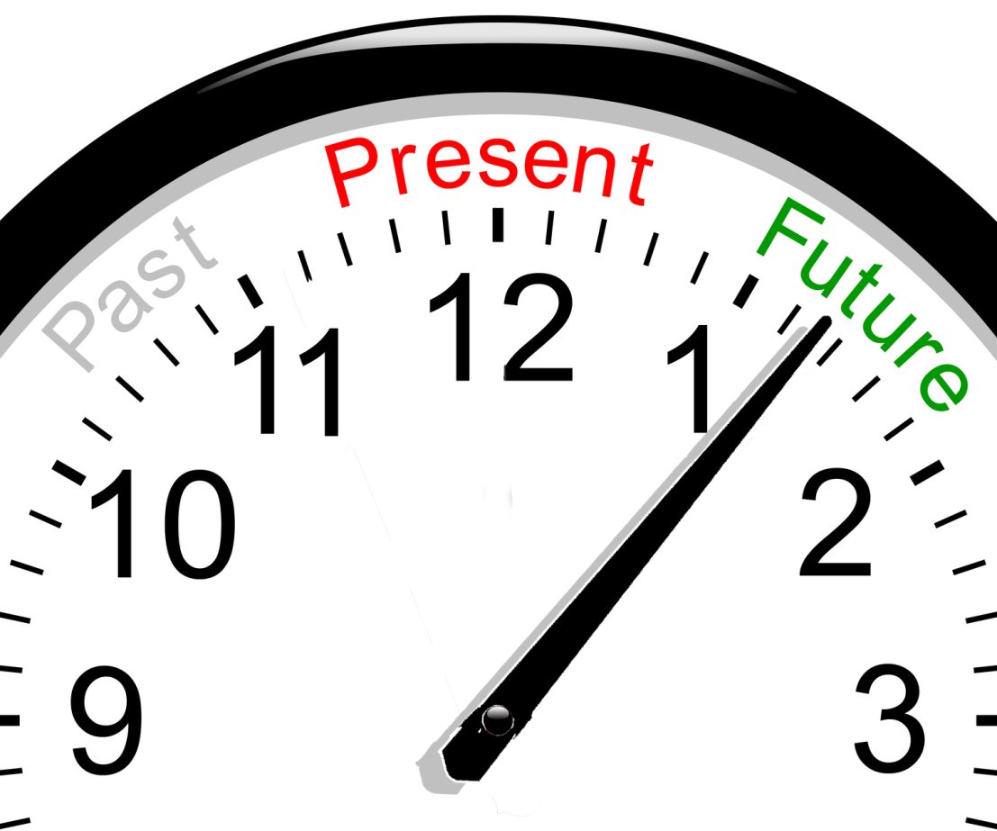

Slide 18
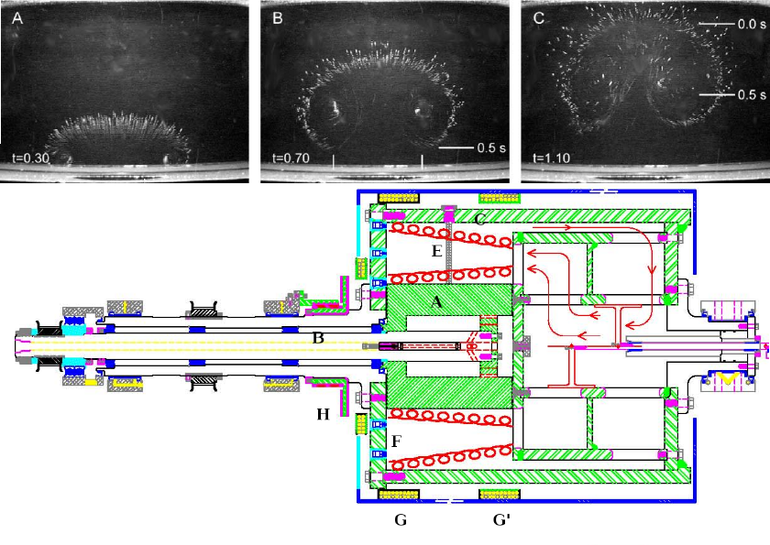
The plan for α-phase

Slide 19
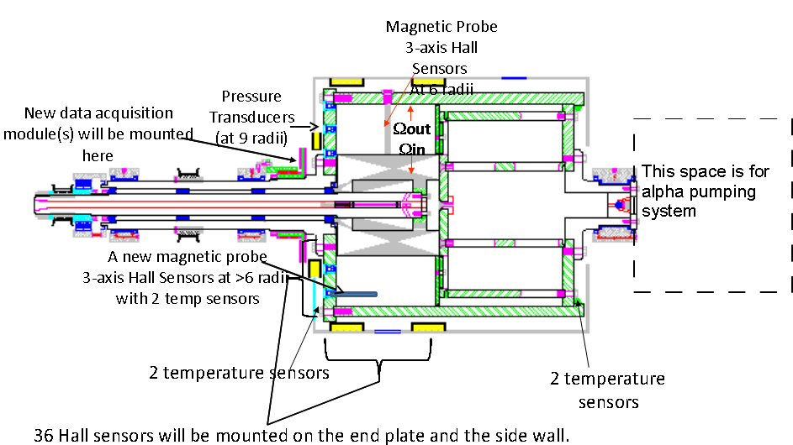
The plan for Data Acquisition (DAQ) upgrade
Velocity probe

Slide 20
Summary
X8 ω-gain has been observed. This means a complete αω-loop can be achieved by converting >1/8 portion of toroidal flux to poloidal direction.
Design of α-phrase is underway, NM dynamo provides best chance to demonstrate full alpha-omega loop.
NM dynamo allows varying the level of turbulence in the fluid to further explore the role of turbulence in dynamos.
The fluid Re up to 10⁷ provides access to a new regime in pure hydrodynamics.

Slide 21
Acknowledge
We gratefully acknowledge
The funding over the years by NSF, LANL via a cooperative arrangement with NM-Tech, and the IGPP program at LANL.
The facilities of NM-Tech, machine shop, administration, EMRTC, CMSO, and many others have made this development possible.
U-Wisc dynamo group for sharing their knowledge, experience, and donating their equipment.
National Instruments graciously lent us DAQ hardware and provided consultation for free.
Many undergraduate students have participated in this project.
The LANL/LDRD program and the DoE/OFES via Center for Magnetic Self-Organization.
The support from Colgate family.

Slide 22
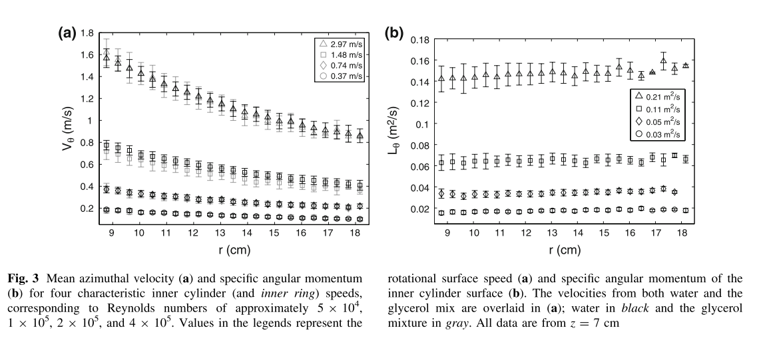
In highly turbulent state, angular momentum profile tends to be flat in the bulk
From M.J.Burin, E.Schartman, H.Ji, Exp Fluids 2010
There are also simulations, e.g. H.J.Brauckmann and B.Echhardt, J. Fluid Mech. (2013)

Slide 23
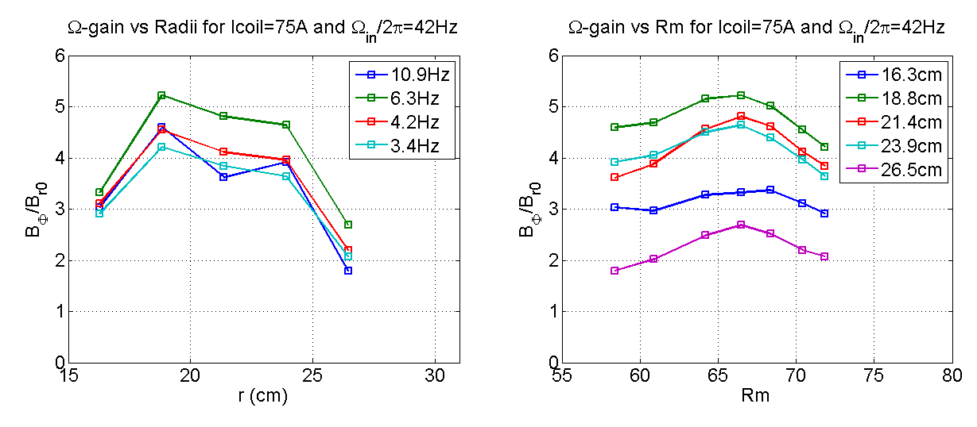
The ω-gains were also measured by spinning down the outer cylinder to make the flow unstable

Slide 24
Direct velocity field measurement will improve our understanding of processes inside the apparatus
Rm>>1
can be inferred from
and
The same method is also used by dynamo group in Leon, France (Miralles, et al, PHYSICAL REVIEW E, 2014).
Rahbarnia et al, ApJ 2012
U-Wisconsin Dynamo group

Slide 25
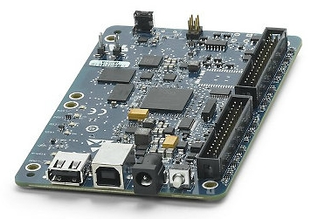
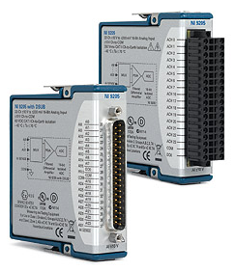
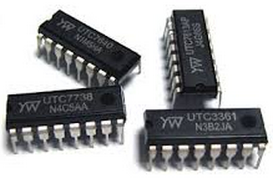
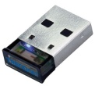
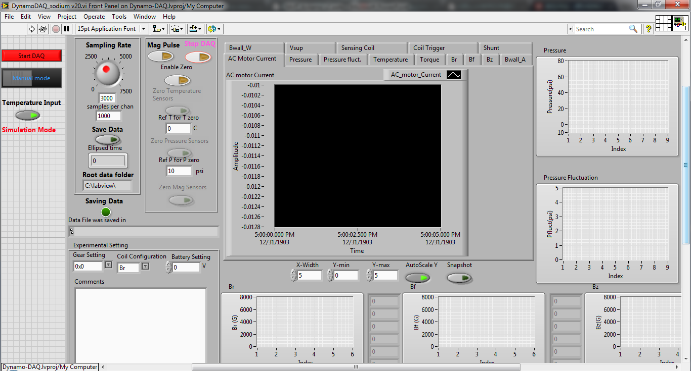
New DAQ will use National Instruments modules, data will be transmitted via WiFi from rotating frame
+
+
+
WiFi adapter
NI single-board computer
ADC module
Power supplies, amps, etc
+
Labview DAQ software

Slide 26
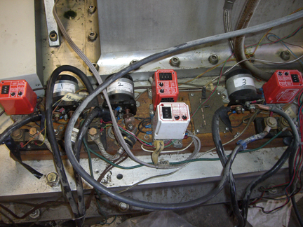
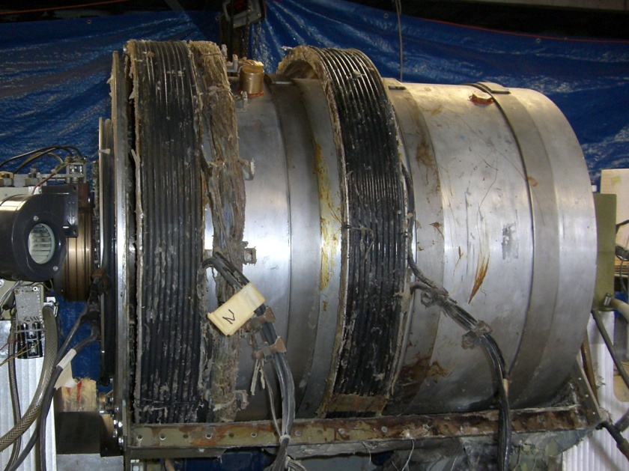
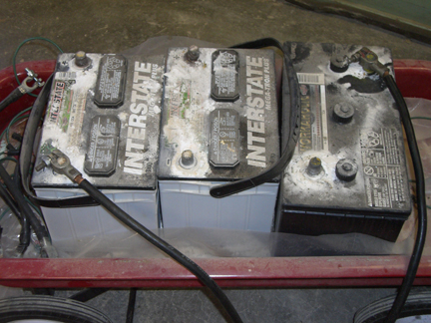
Car batteries (6 to 48V) are used to drive magnetic coil currents
0-10s
Magnetic field Coils
Control
timer
Relay
+
-
+
-
+
-
shunt

Slide 27
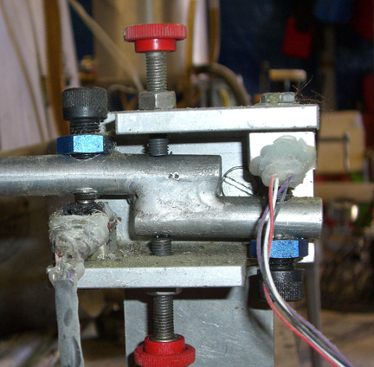
The torque on the spinning outer cylinder can be measured through a gimbaled dc motor
AC motor, 50 hp
(gimbaled)
2:1 drive ratio
Force, pressure sensor
Torque arm
L= 1.25(+) & 1.31(-) m
Force
sensors
DC shunt
motor/generator
5 hp, (gimbaled)
FSG15N1A Force Sensors are used to measure:
the DC motor torque = Ekman flow torque = turbulence torque.

Slide 28
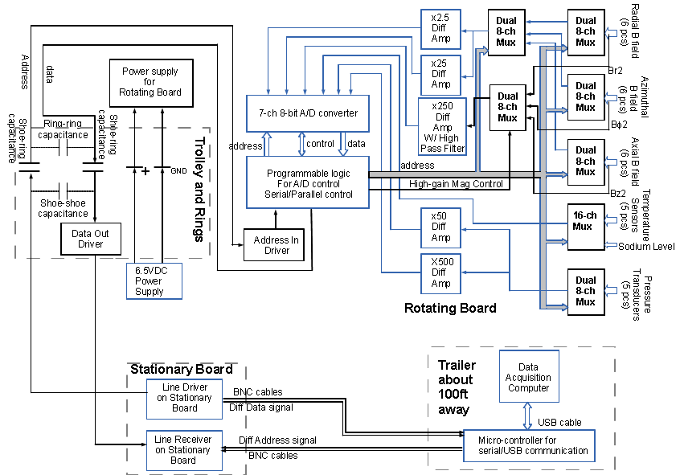
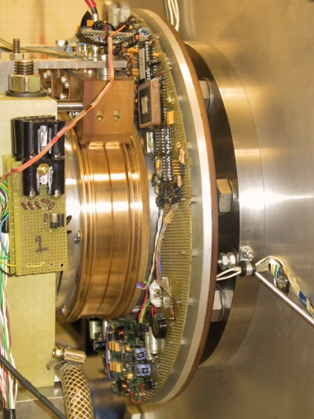
Signals from sensors in the rotating frame are digitized and transmitted though capacitive coupling.

Slide 29
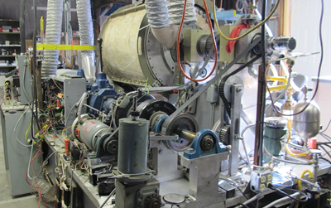
Torque Arm
Force Sensor

Slide 30
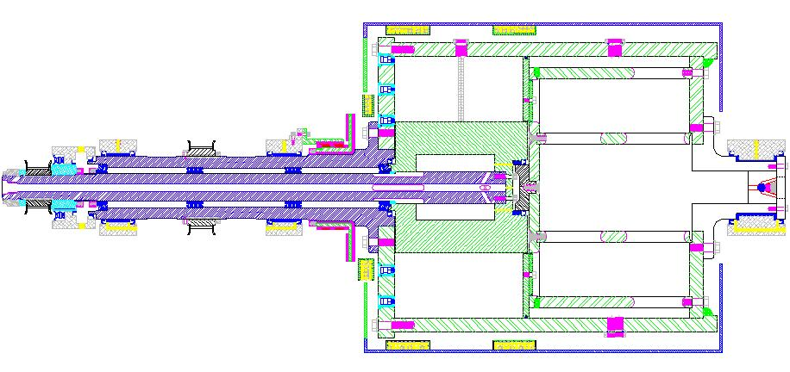
The experimental apparatus had been refitted during 2013
A hot oil circulation system has been implemented to prevent sodium from solidifying on the seal and rollers
9 new pressure sensors have been mounted
We decided to make the outer cylinder stationary to maximize the angular momentum transport
The shell bearings are replaced by roller bearings to reduce the friction.
8-bit DAQ system was replaced by an NI 16-bit DAQ system for the current purpose.
We also improved our methods for storing, filling, heating and dumping Na.

